Slide 1

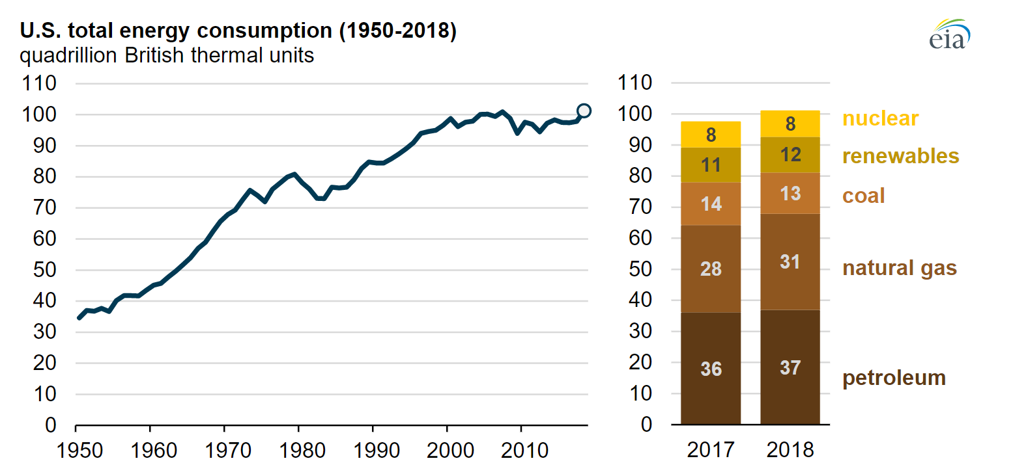
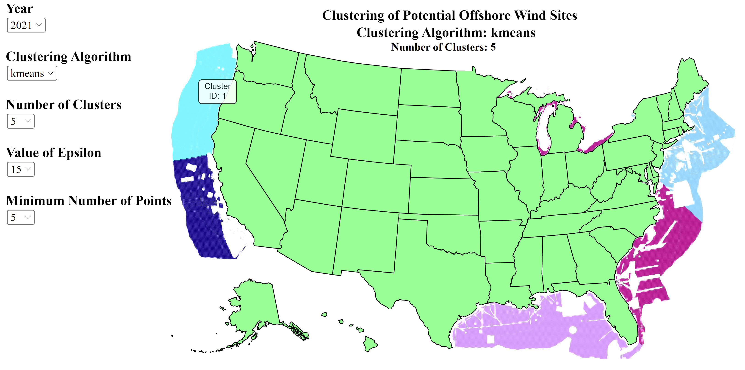
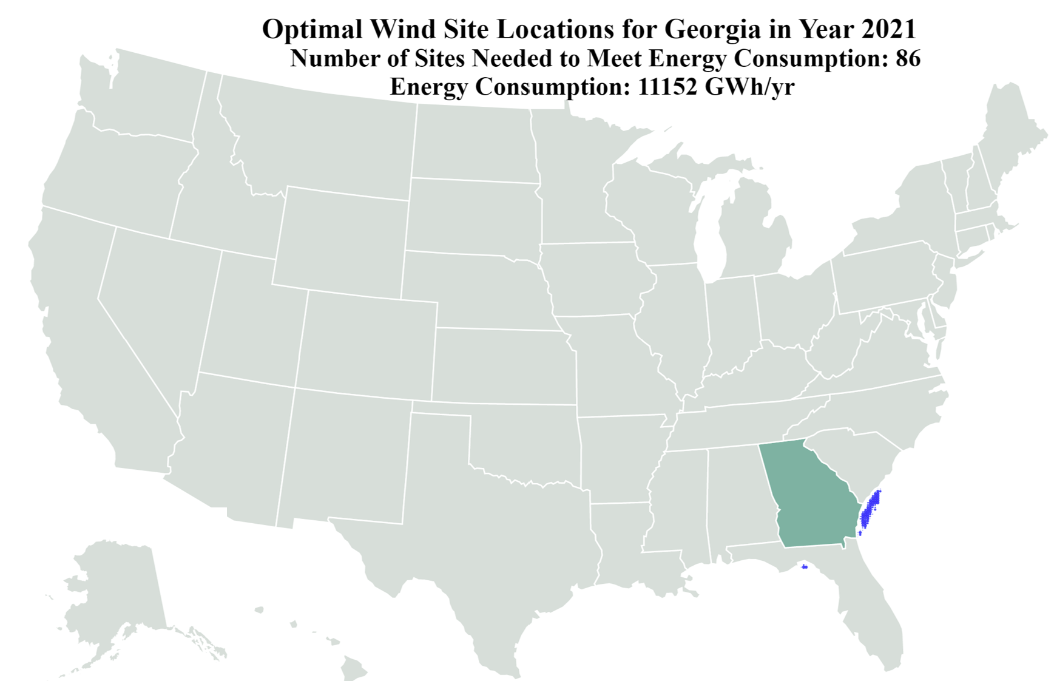
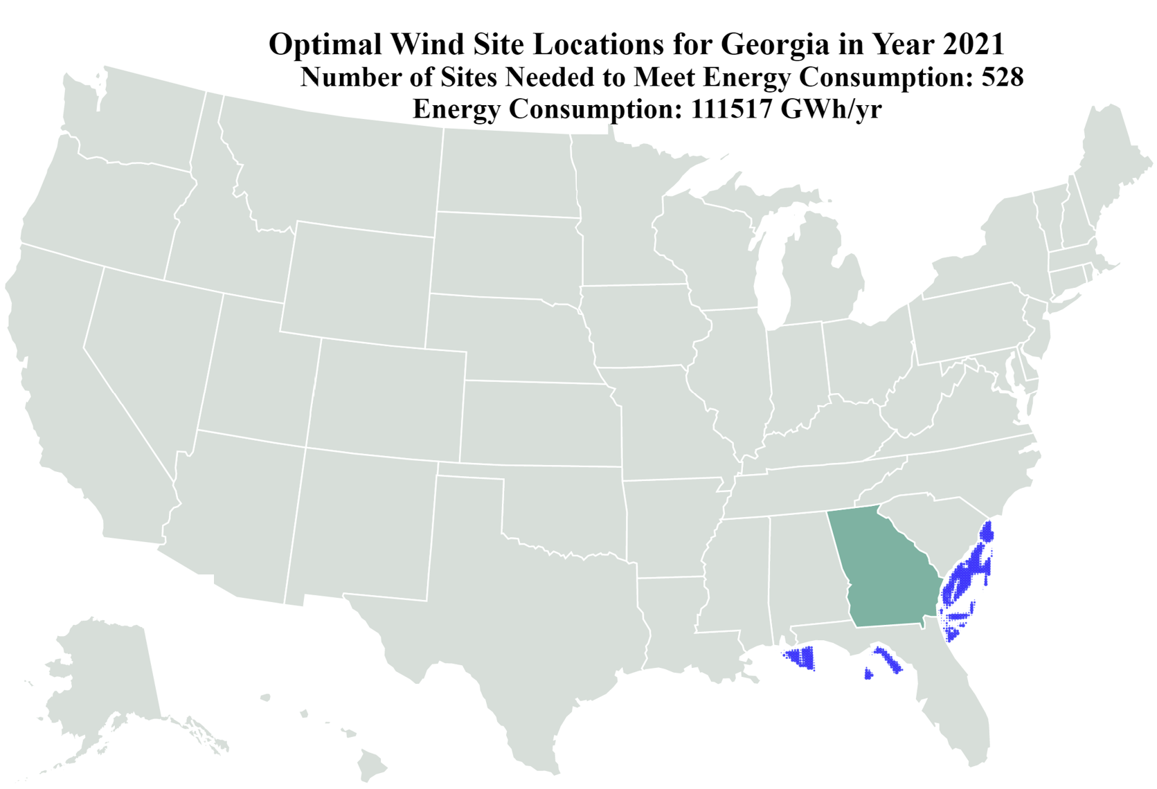
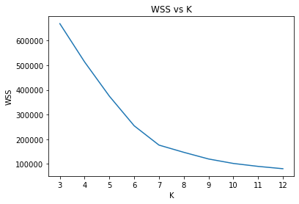
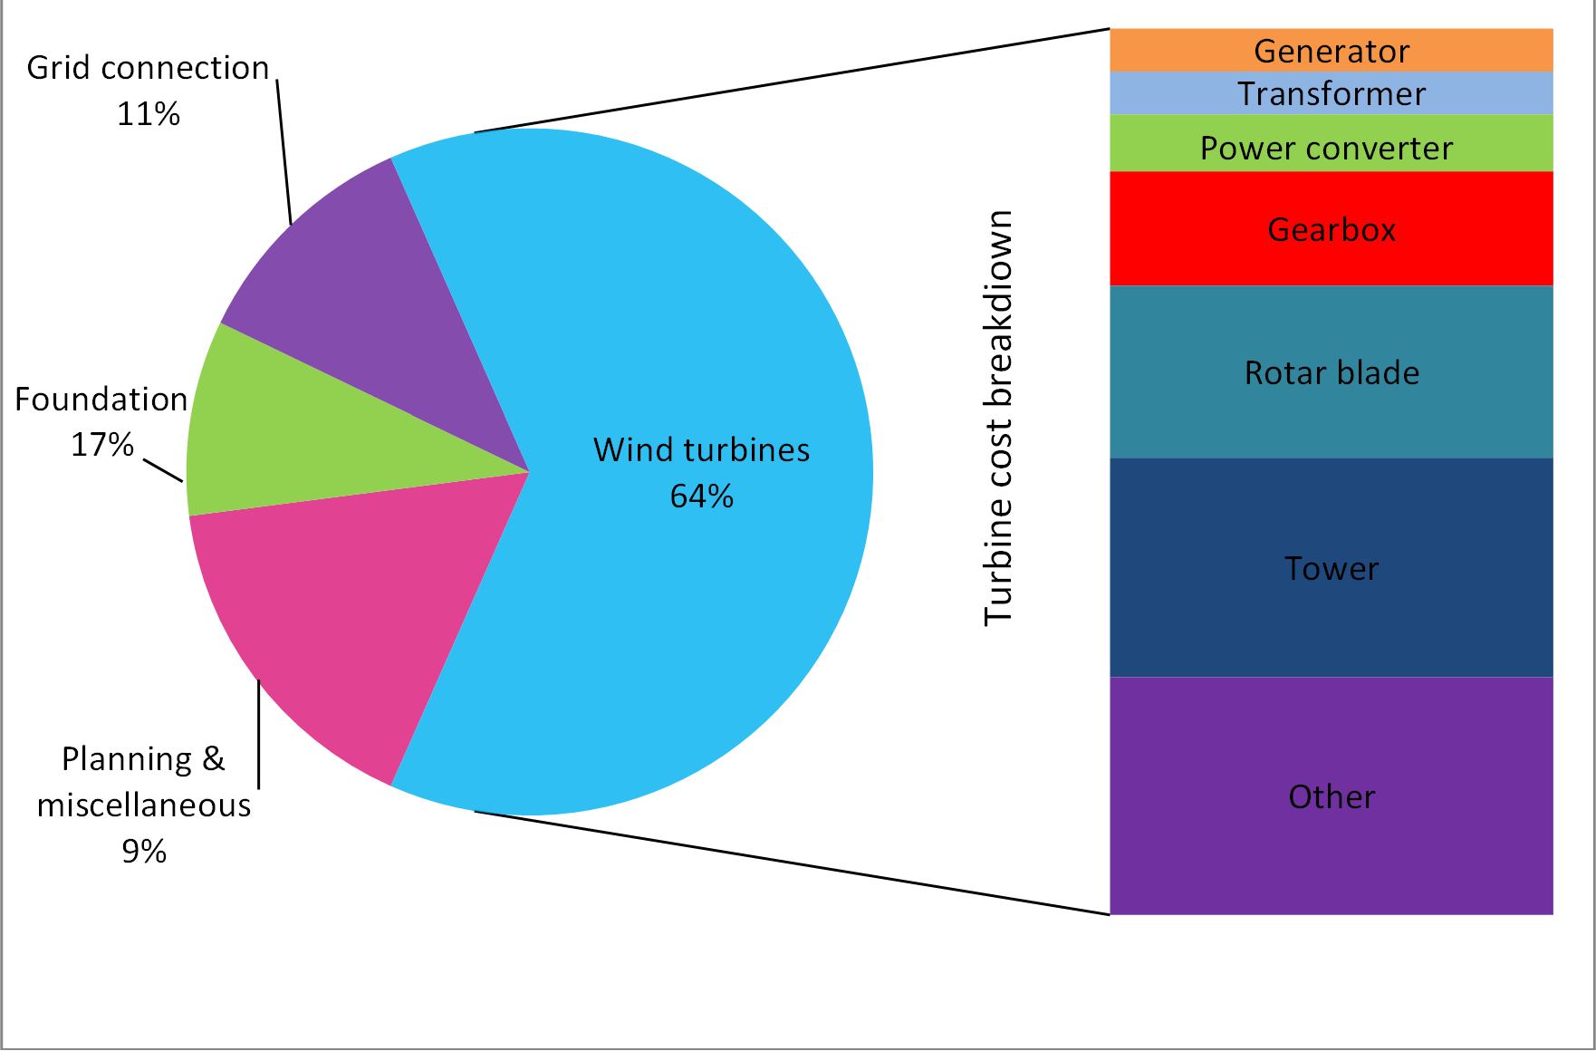
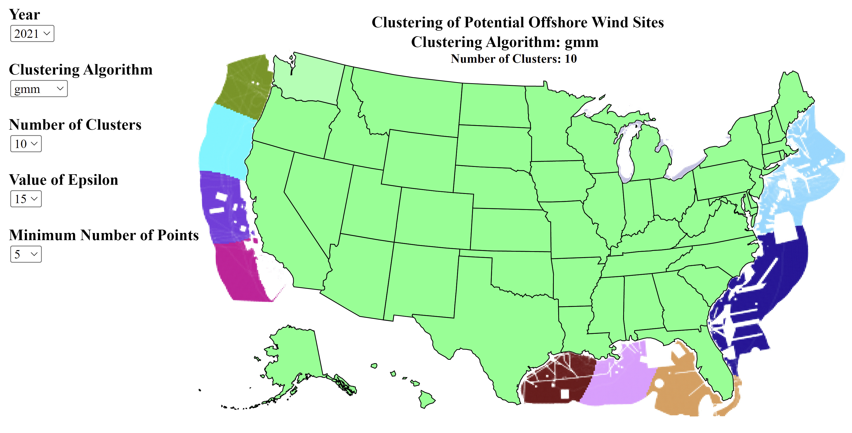
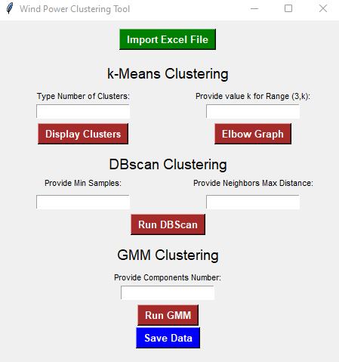
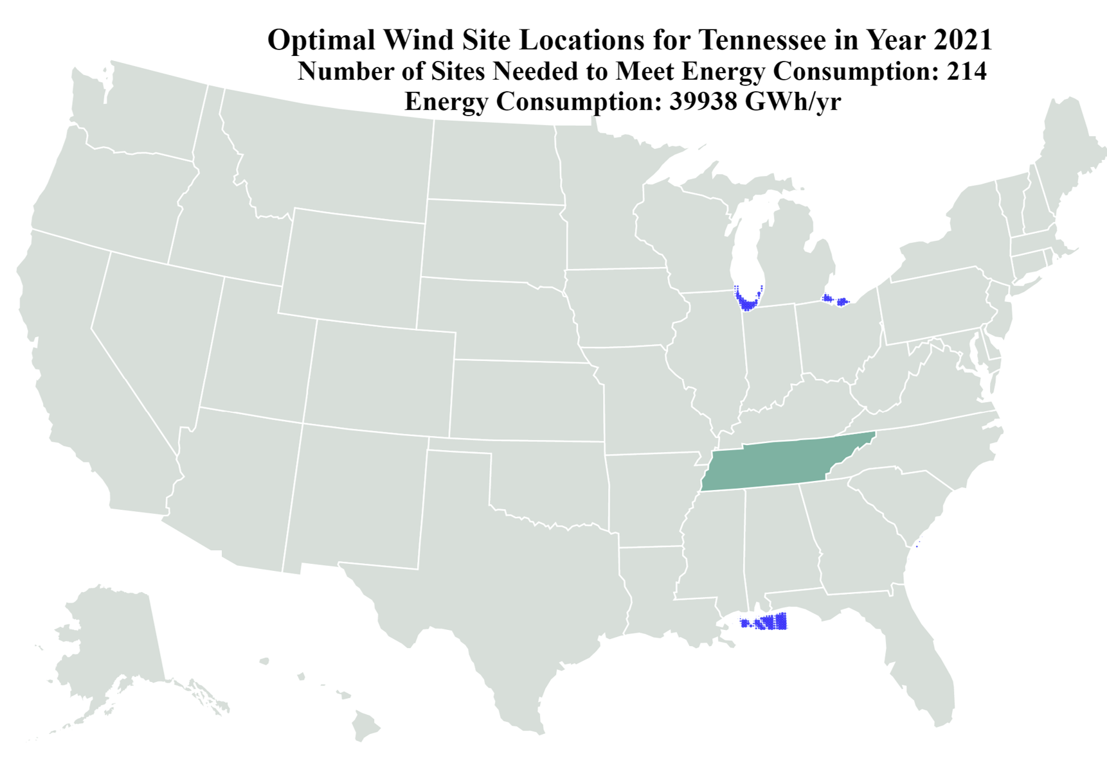
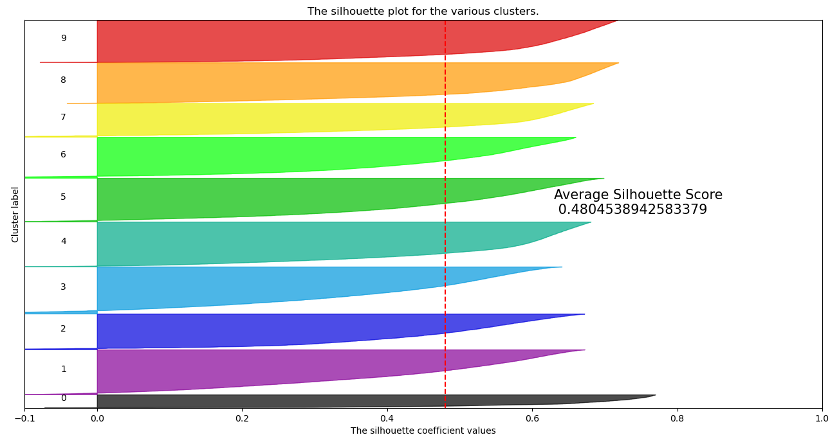
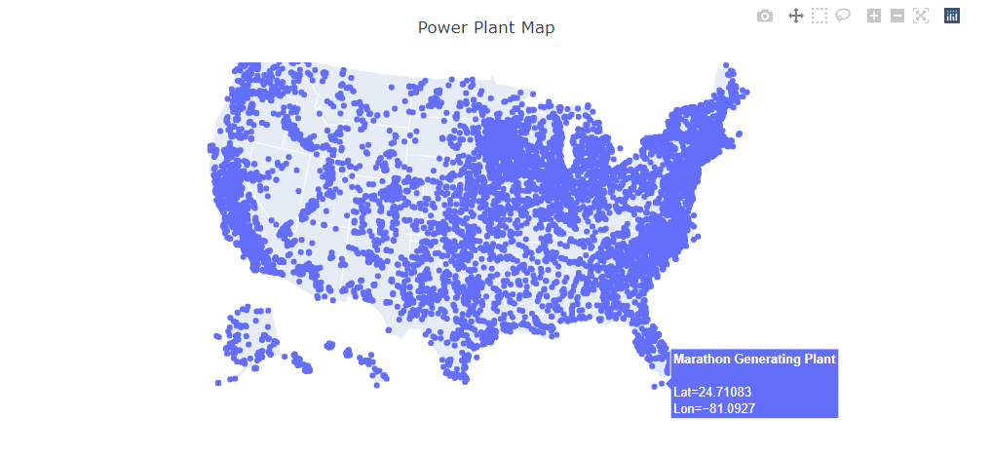
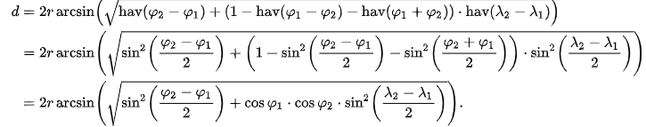
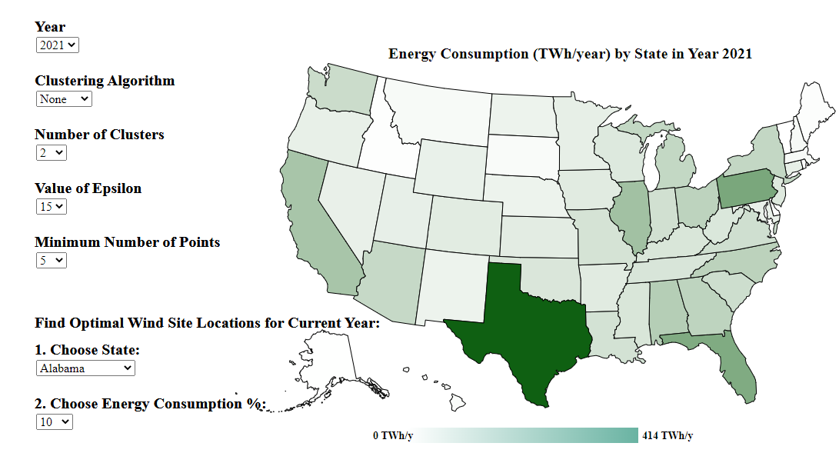
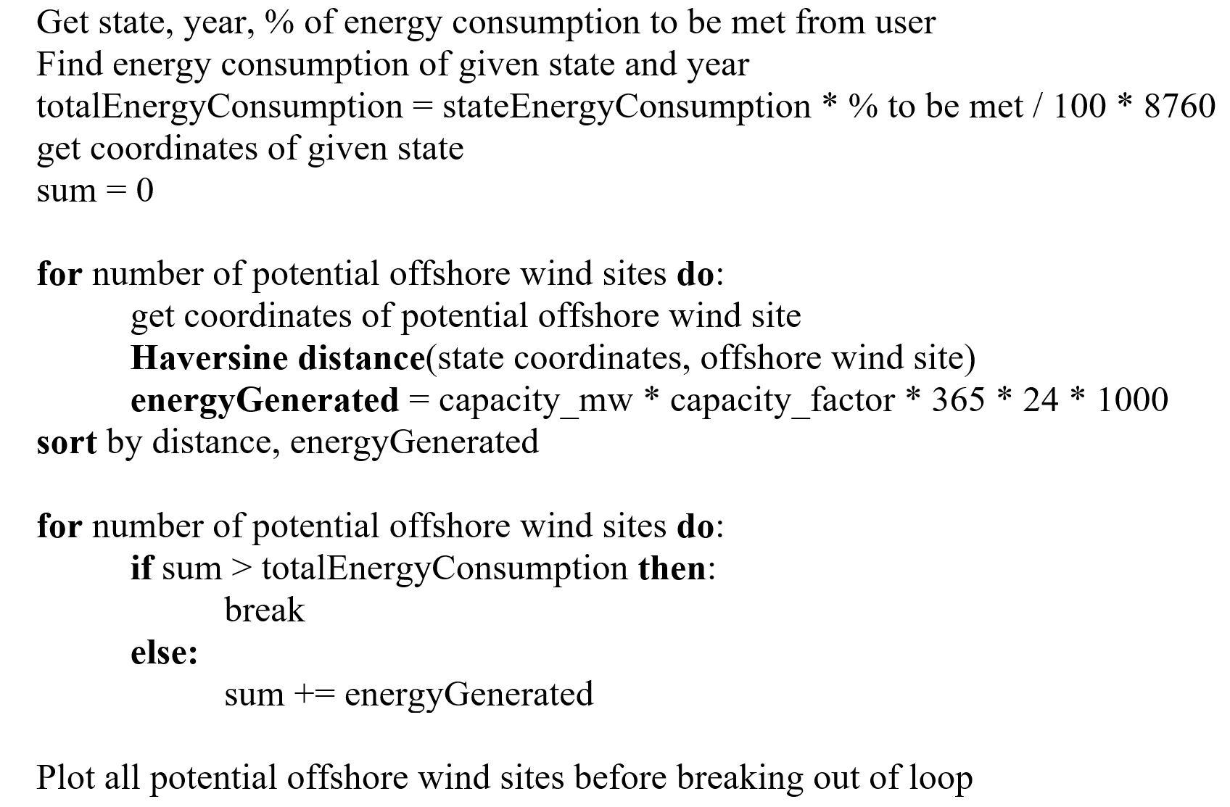
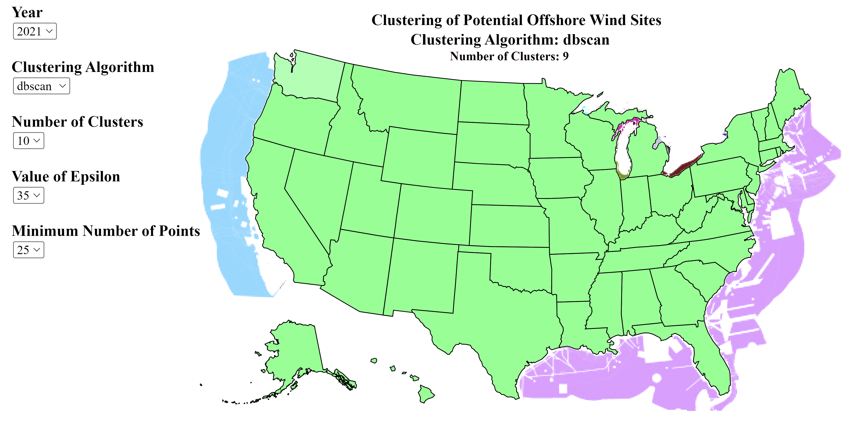
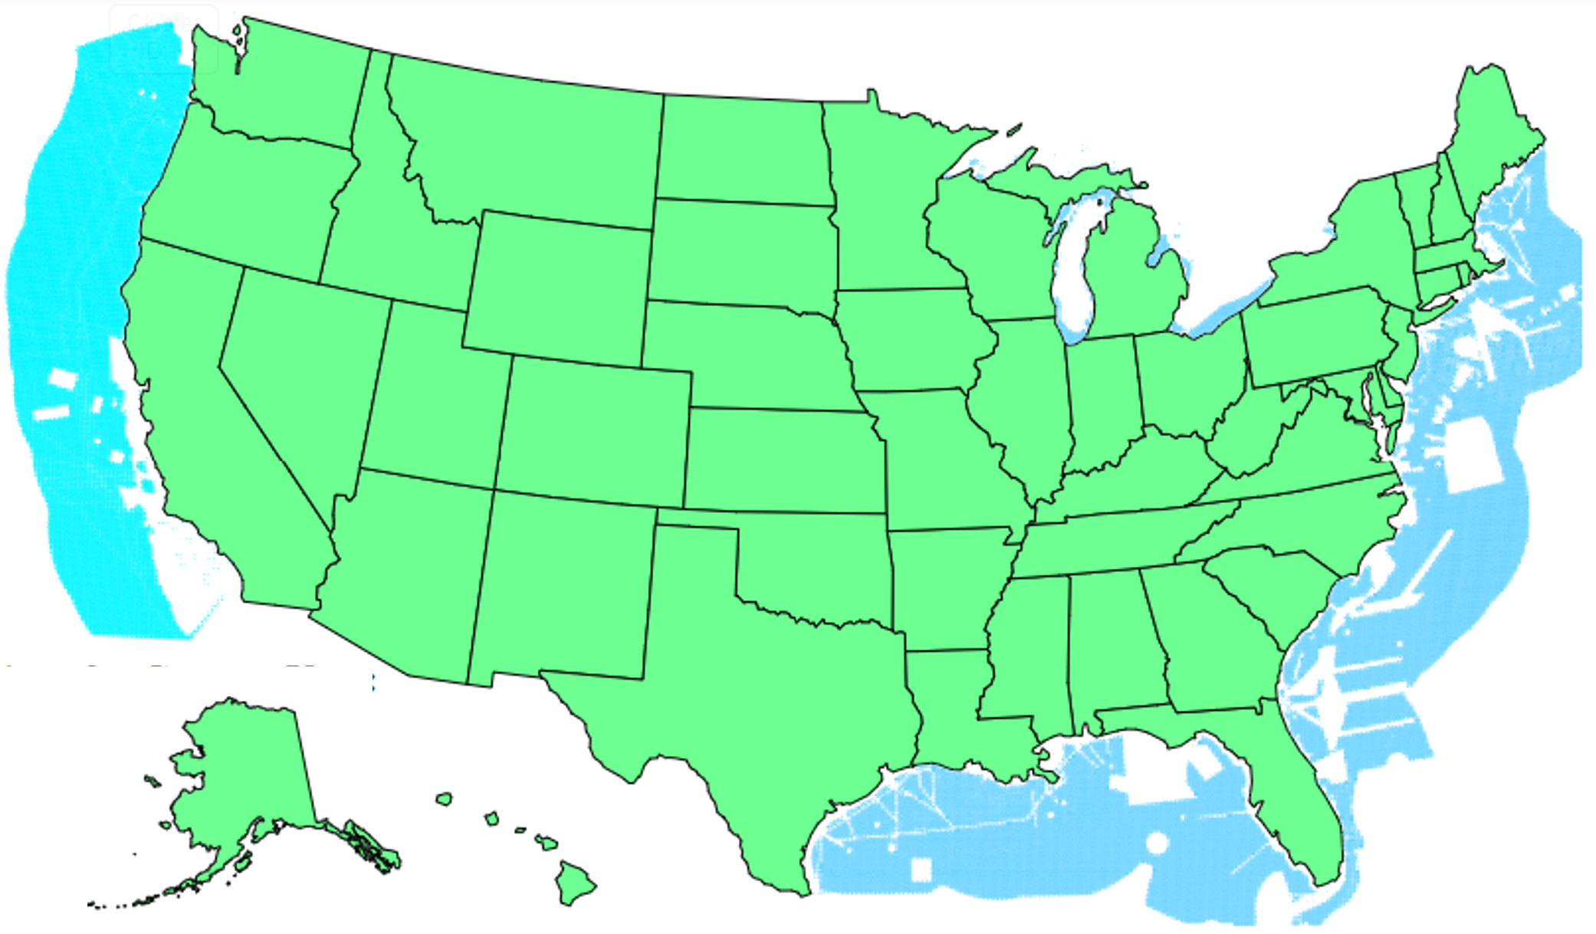
Clustering Tool for Offshore Wind Power Stations
Walker Hills, Madison Manley, Shane Oh, Matthew Sandry whills3@gatech.edu, mmanley31@gatech.edu, shaneoh@gatech.edu, msandry3@gatech.edu
Overview
Methods
Experiments
Optimization Model Results
Energy consumption in the United States (US) is rapidly increasing
Offshore wind power generation is an attractive source of renewable energy. However, building offshore wind power generation stations requires careful planning.
In our project, we present an interactive tool to visualize and analyze optimal wind farm sites. We aim to minimize the operating and variable costs in wind power while requiring to meet a certain percentage of current energy generation.
In this project, we used three different types of clustering algorithms: (1) K-means clustering, (2) gaussian mixture models (GMM), and (3) density-based spatial clustering of applications with noise (DBSCAN).
We clustered the potential sites because offshore transmission lines are expensive; thus, it is efficient to have offshore power stations that collect connect to adjacent mills. The cluster size cannot be too small, because power stations are expensive and cannot be too large, due to the inefficiency of lengthy connections.
We developed a GUI to enable users to interact with their dataset and create their own clusters and find the optimal parameters for each method. Our approach is unique in a way that we utilize different clustering algorithms mentioned as above, all while visualizing the data in a presentable manner. Planners and elected officials alike can make informed choices with our visualization tool.
Below is the following pseudo-code of the algorithm and formulas we used to find the optimal wind site locations where the user choses the state, given year, and % of energy consumption needs they want met.
Clustering
For K-means clustering, the optimal number of points was found by examining an elbow curve. K values of 1-3 were deemed trivial because the data runs the west and east coast (k = 2). At k = 3, another cluster is added in the Southern US around the Gulf of Mexico. The three clusters are forced by the geographical location of the data.
Gaussian-Mixture Model
For DBSCAN, parameter choice for epsilon and min_points has a significant impact on the clustering algorithm's performance. Values around 50 for min_points and 100 miles for epsilon produced the highest performance as measured by silhouette coefficient. Larger numbers of clusters were achievable with smaller values for both parameters, though finding a high-quality solution took much more fine tuning and still resulted in a silhouette coefficient close to 0.
We tested the optimization model with different test cases. In Figure 10, we compared how many wind farms would be needed to meet 10% and 100% of Georgia’s energy consumption in the year 2021. To meet 100% of the energy consumption 214 offshore wind farms would be needed compared to only 86 offshore wind farms needed to meet only 10% of the energy consumption.
One interesting case we observed is for the state of Tennessee. Our model prioritizes location over the energy generation of a potential wind farm. This is where the clustering algorithm chosen, and its parameters would impact the optimization model. Considering the clustering algorithm and centroid locations, the optimal wind farm locations could instead be clustered in one area instead of two.
Algorithm | Pros | Cons
K-means | Scalable; quick | Prone to noise; difficult to identify outliers
GMM | Resistant to outliers; quick | Complex algorithm
DBSCAN | Cluster size can be different shape/size; resistant to outliers | Sensitive to epsilon and min_points
Figure 1. Historic Energy Consumption in the United States [1].
Table 1. Advantages & Disadvantages of Clustering Algorithms
(b)
(a)
(b)
(a)
Figure 10. (a) Potential Wind Farm Locations for Meeting 10% (a) and 100% (b) Energy Consumption of Georgia in year 2021.
Figure 7. (a) K-means Clustering (K=5). (b) Elbow Curve
Figure 2. Cost breakdown of Wind Site [2].
(a)
Data Collection
Net power generation for the years 2001-2021 was gathered through Energy Information Administration’s (EIA) API to create total power generation of US states. A snapshot of the data is shown in Figure 3.
We downloaded a dataset from the National Renewable Energy Laboratory (NREL) for potential offshore wind farm sites, the area, the wind speed and their potential for power generation [3]. This dataset has 19427 records has a size of 1.8 MB.
(b)
Figure 11. (a) Potential Wind Farm Locations for Meeting Energy Consumption for Tennesse
Figure 8. (a) GMM Clustering (Clusters=10). (b) Silhouette Score
User Interface Design
Figure 5. Graphical User Interface (GUI) for clustering the data.
We used JavaScript to design a user interface. The user can look at how different algorithms cluster the offshore potential wind sites and the energy consumption of different years. The user can also find optimal wind power locations given that the user chooses the state, year, and % of energy consumption they want met.
Figure 3. Active Power Plants in the US.
Haversine distance:
Figure 12. User Interface Design
References
[1] A. McFarland, “In 2018, the United States consumed more energy than ever before,” U.S. Energy Information Administration (EIA). [Online]. Available: https://www.eia.gov/todayinenergy/detail.php?id=39092. [Accessed: 23-Apr-2022]. [2] https://www.irena.org/costs/Charts/Wind [3] “Wind Data and Tools,” NREL.gov. [Online]. Available: https://www.nrel.gov/wind/data-tools.html. [Accessed: 23-Apr-2022].
Figure 4. Potential Offshore Wind Farm Sites.
Figure 6. Pseduo-Code of Optimization Model Implementation.
Figure 9. DBSCAN Clustering (Clusters=9).

